Slide 1
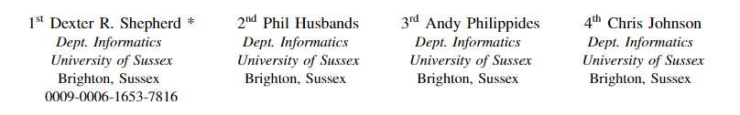




Versatility of Low-Resolution Tactile Sensing for Edge and Pose Detection

Slide 2
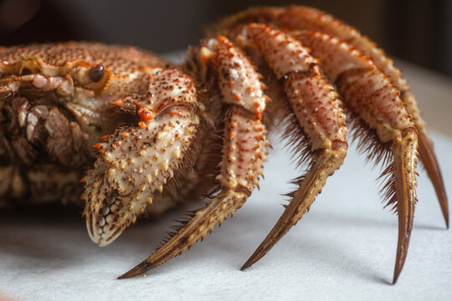
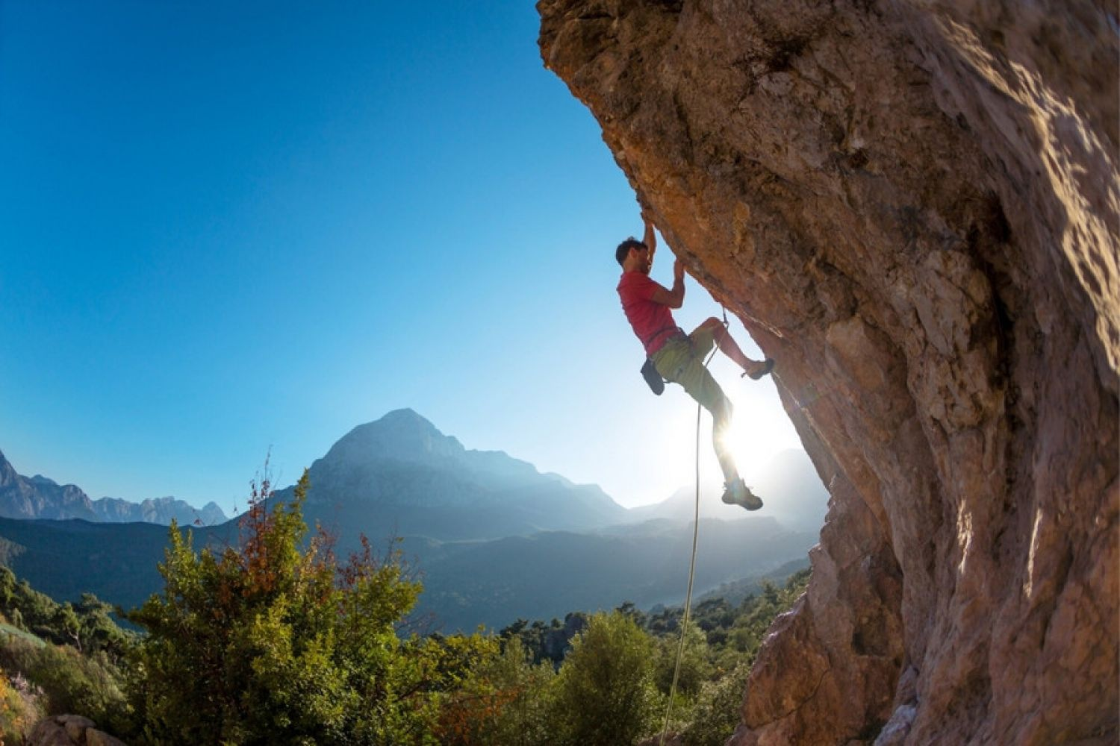
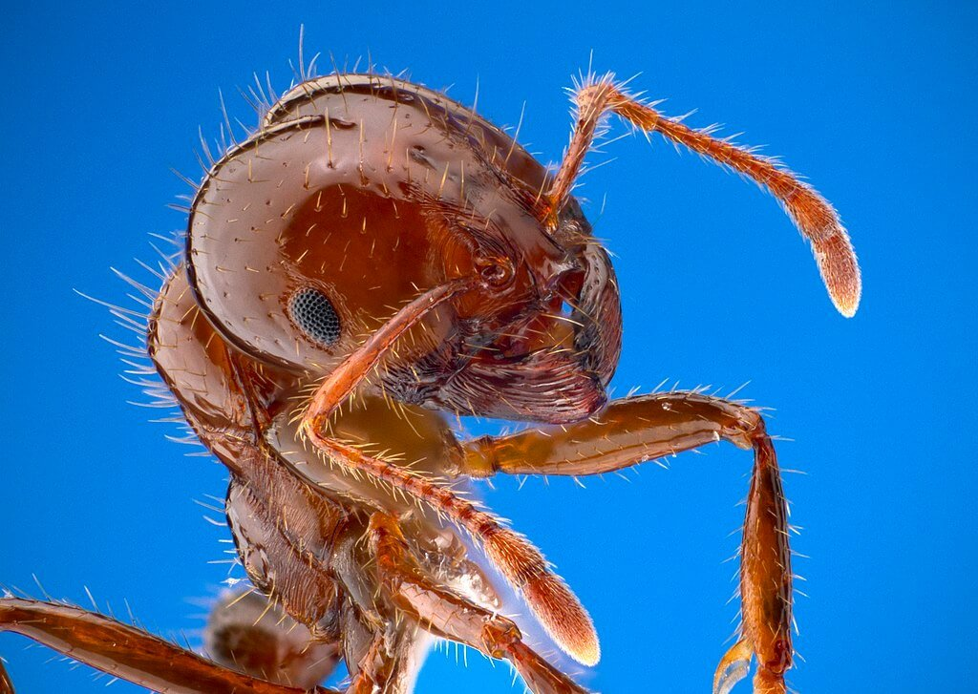
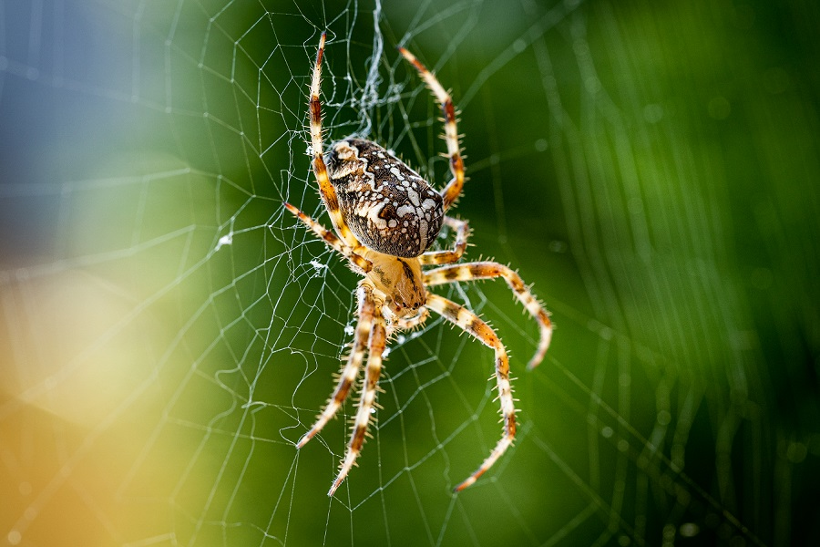
Introduction
Tactile sensing is found across nature
Tactile feedback enables biological agents to traverse over challenging terrain

Slide 3
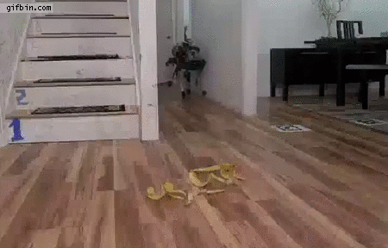
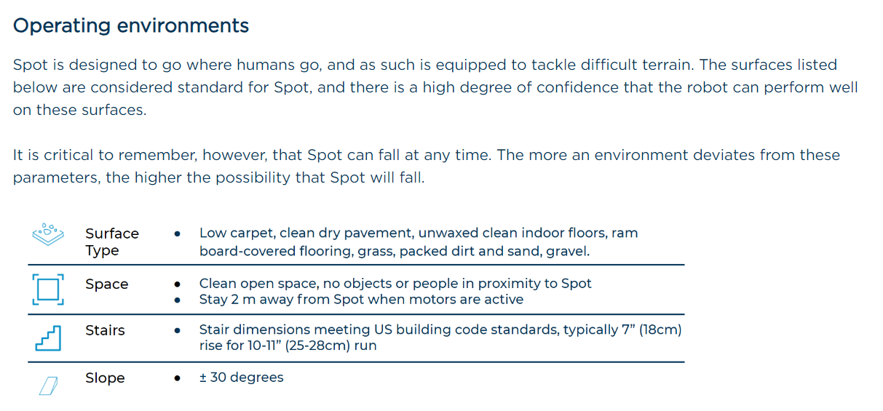
Why should this be any different in Robotics?
Understanding ground properties and how this influences the robots state is key to balancing
Even state-of-art robots have limitations

Slide 4
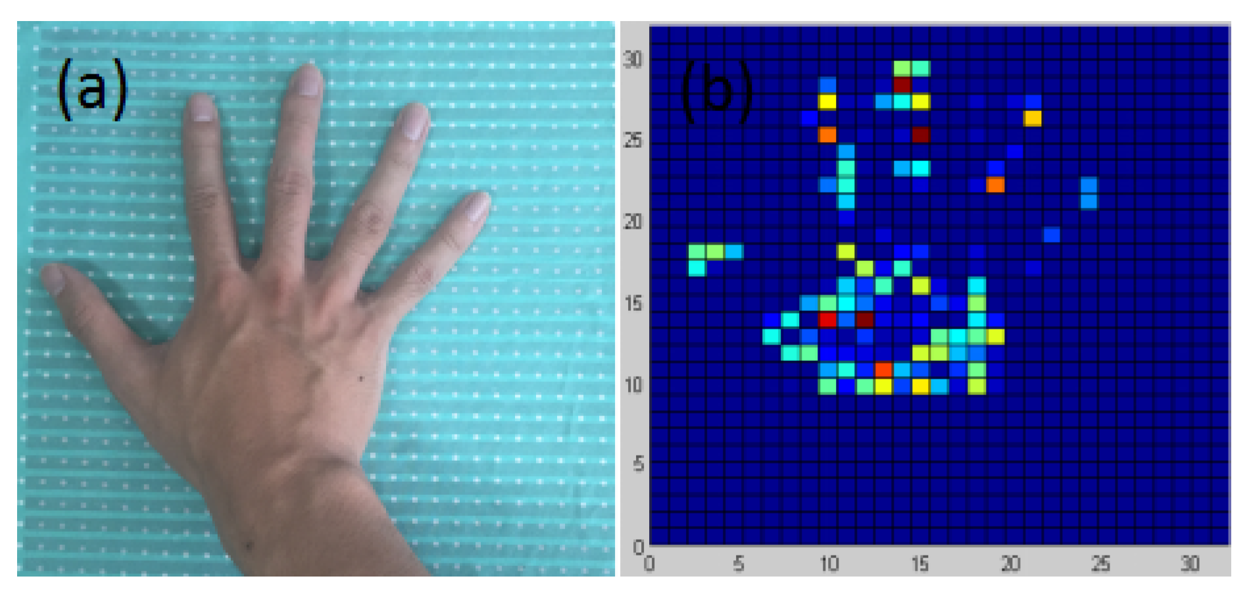
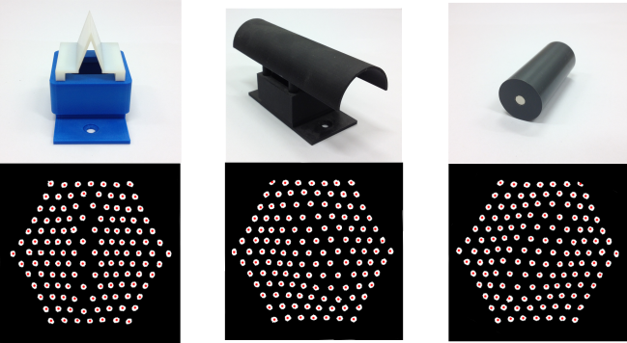
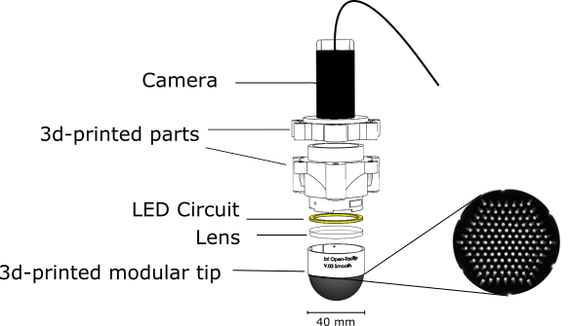
Popular approaches
Optical
Force-resistive (electrical)
MDPI and ACS Style
Sun, C.; Li, W.; Chen, W. A Compressed Sensing Based Method for Reducing the Sampling Time of A High Resolution Pressure Sensor Array System. Sensors 2017, 17, 1848. https://doi.org/10.3390/s17081848
Ward-Cherrier, Cramphorn, Lepora (2017) Exploiting sensor symmetry for generalized tactile perception in biomimetic touch
Notes:
Key arguments of both:
Optical higher spatial resolution
Electrical less processing
Optical mainly used for hands, less literature for feet

Slide 5
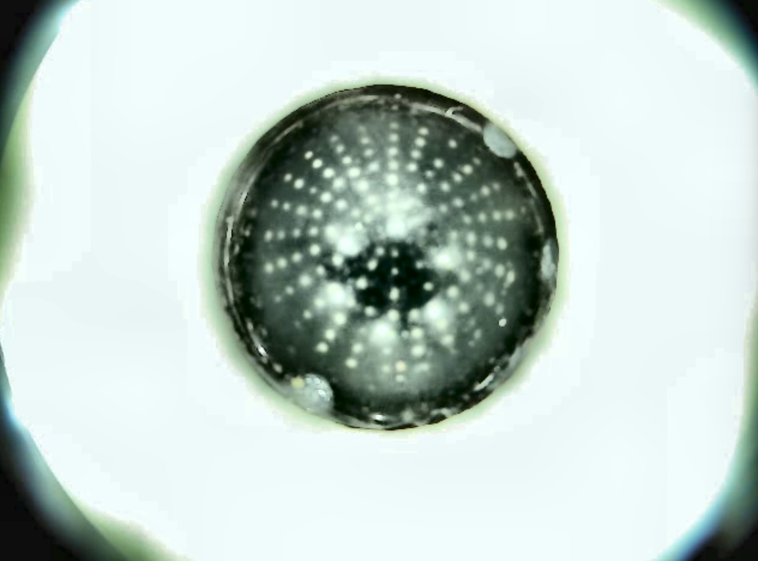
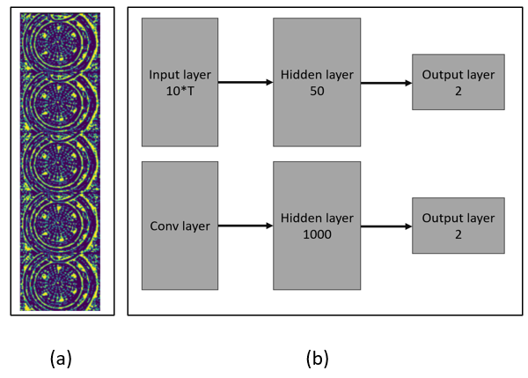
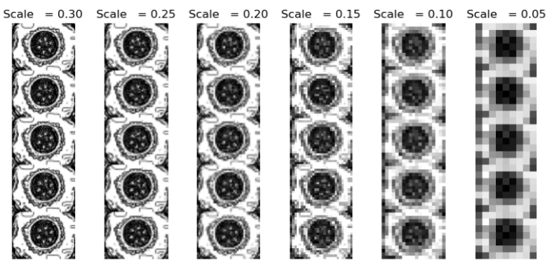
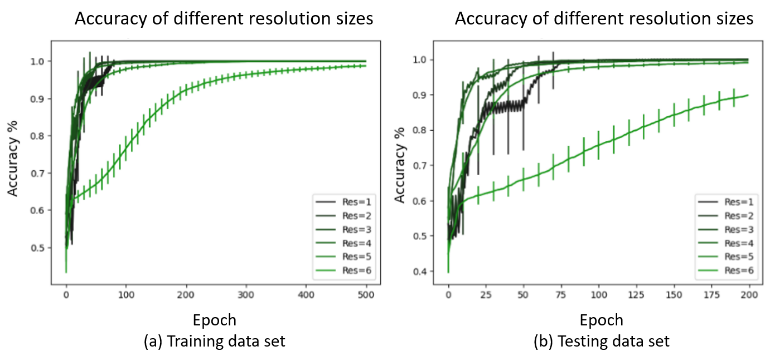
Resolution and accuracy
Reduction on scaling did not seem to make a significant difference
Using an ANN
Notes:
More preliminary testing

Slide 6
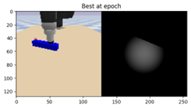
Our questions
How much information can we get with a cheap low-resolution sensor?
We performed edge detection and pose detection using custom low-resolution sensors

Slide 7
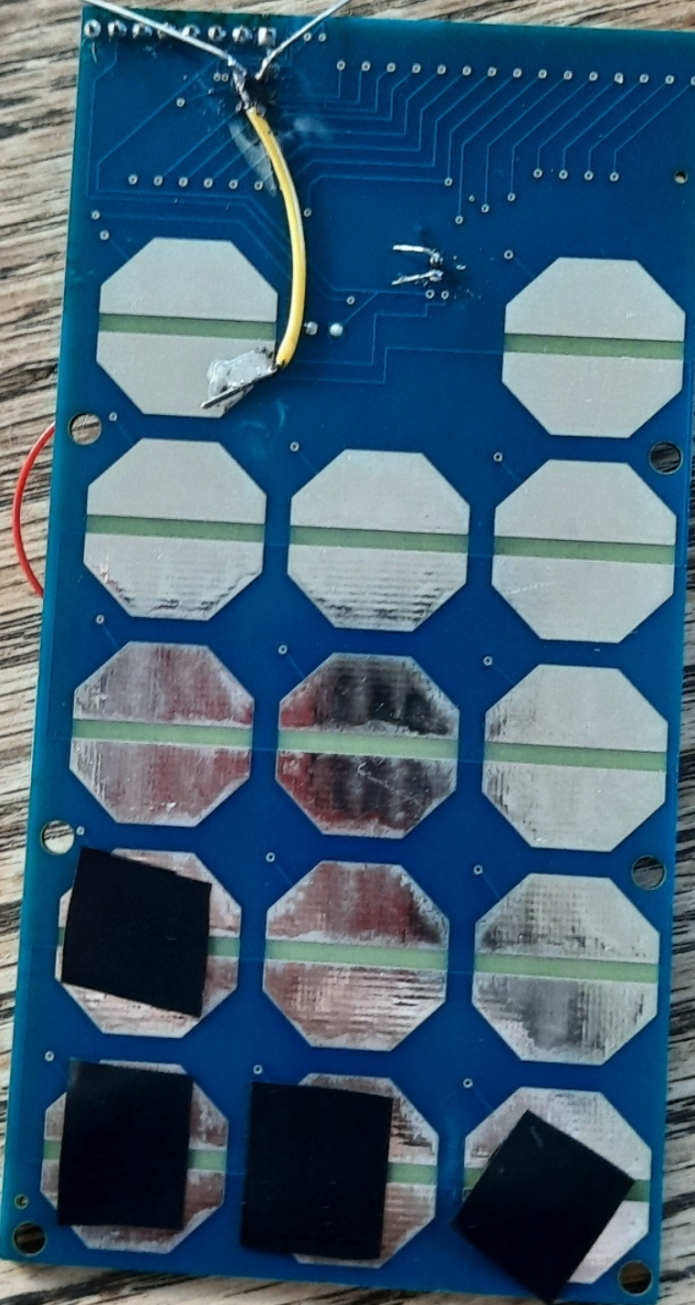
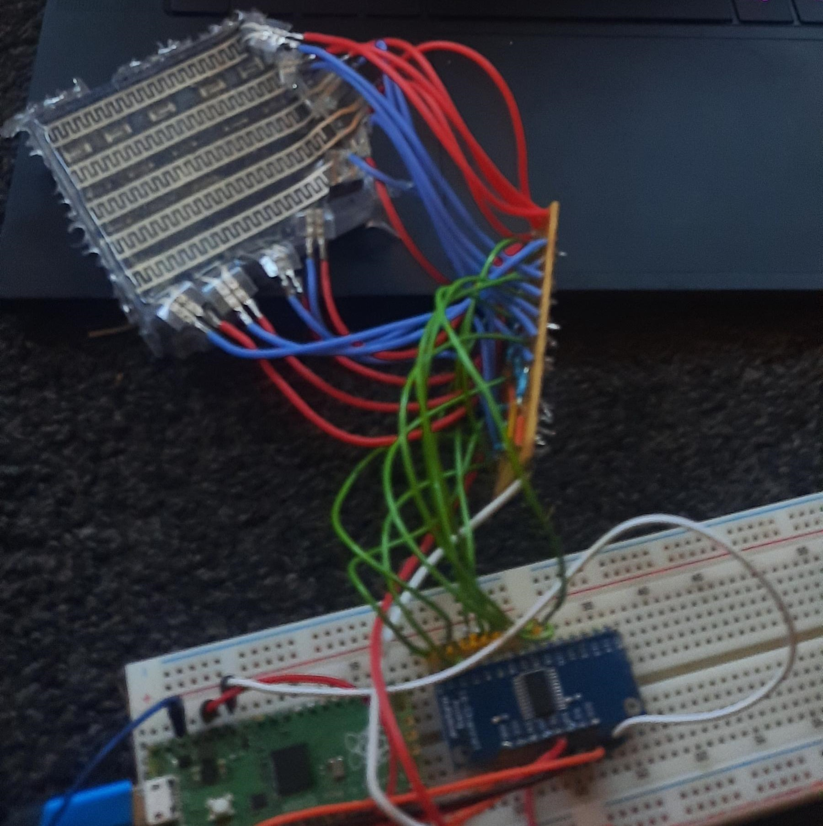
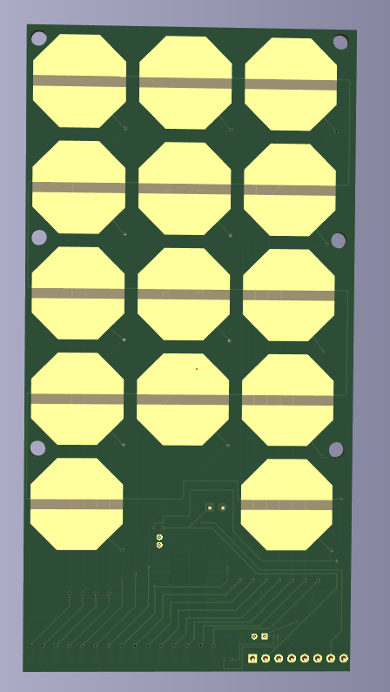
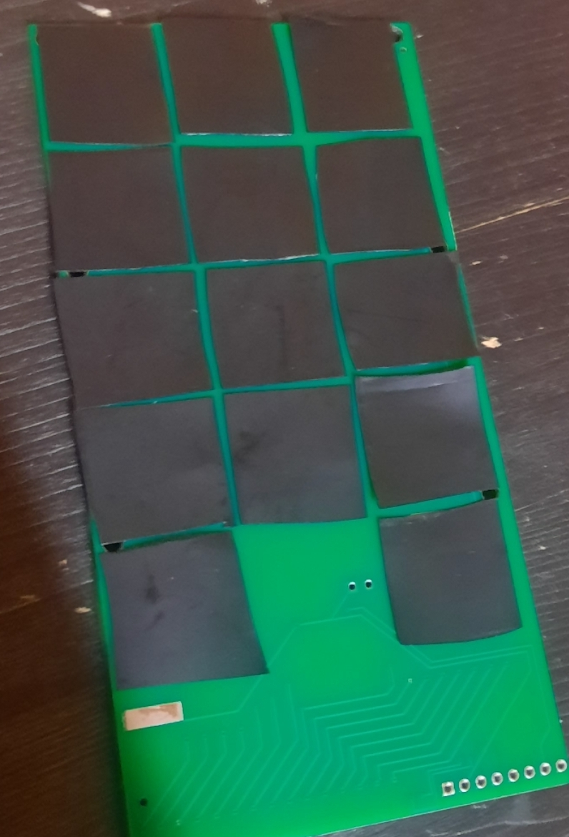
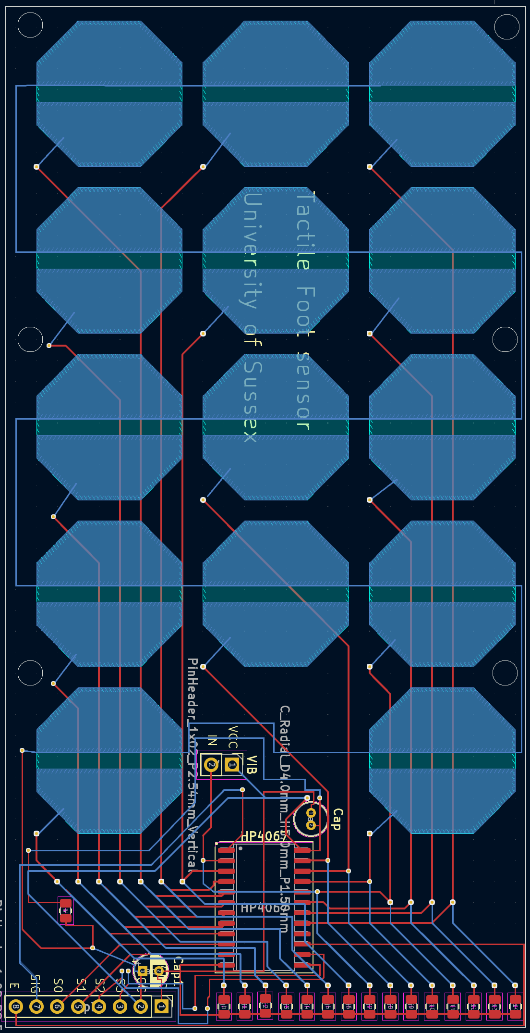
Novel pressure sensor
We developed an array of pressure sensors
Prototype made use of overlapped FSR
Notes:
Uses a velostat material (packaging material)
Has option of vibration but we do not talk about this in this paper

Slide 8

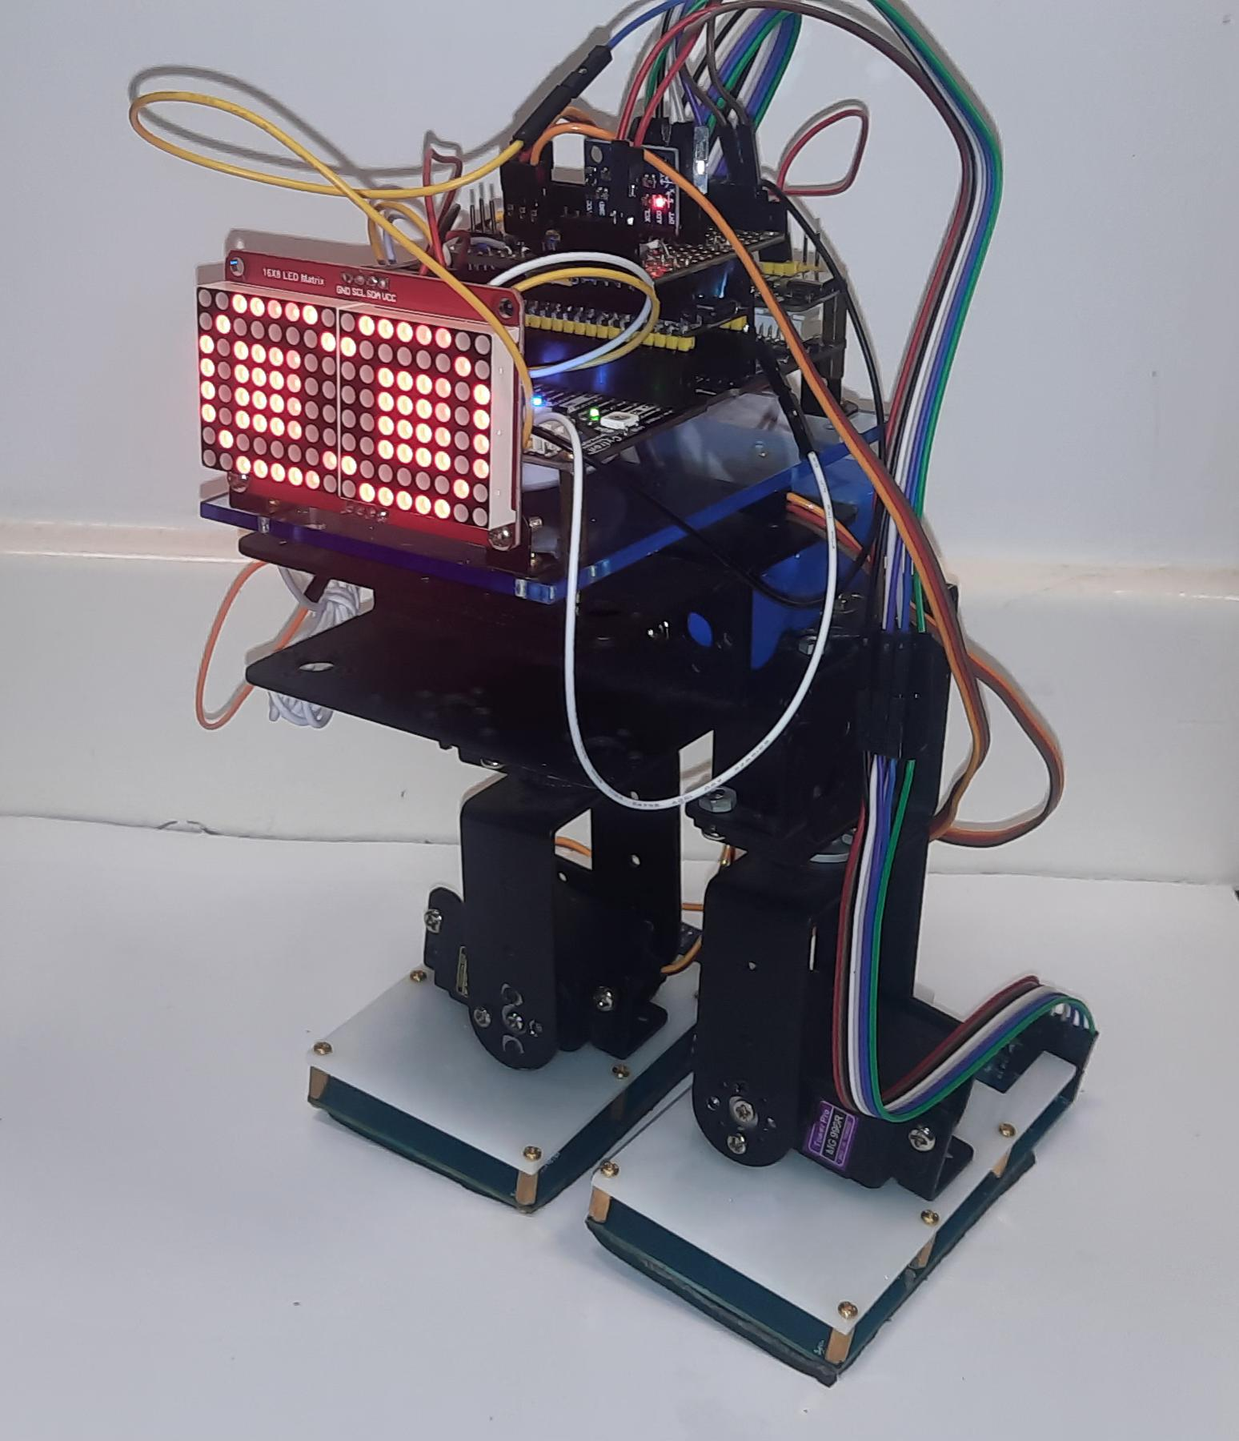
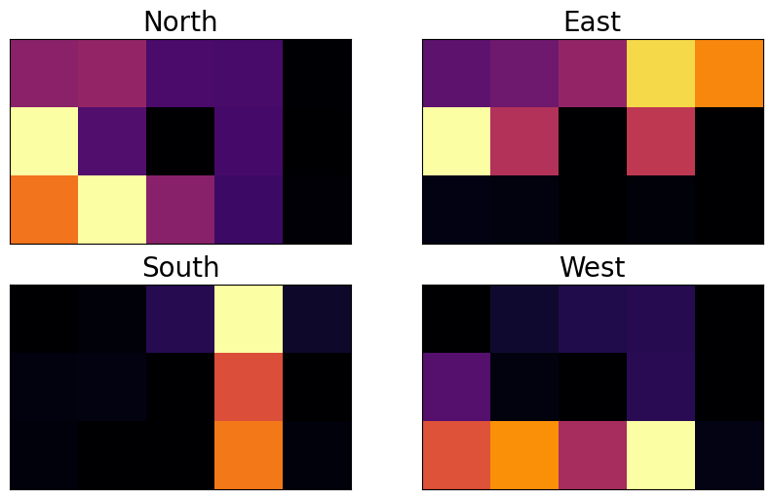
Placement on a robotic chassis
A foam plate is placed on top of the velostat and PCB to hold in in place
The finished sensor is attached to the foot of the 4DOF robot
Tactile pads passed through a bandpass filter
Notes:
Edge detection was quite simple -> already meets one of the benchmark tests

Slide 9
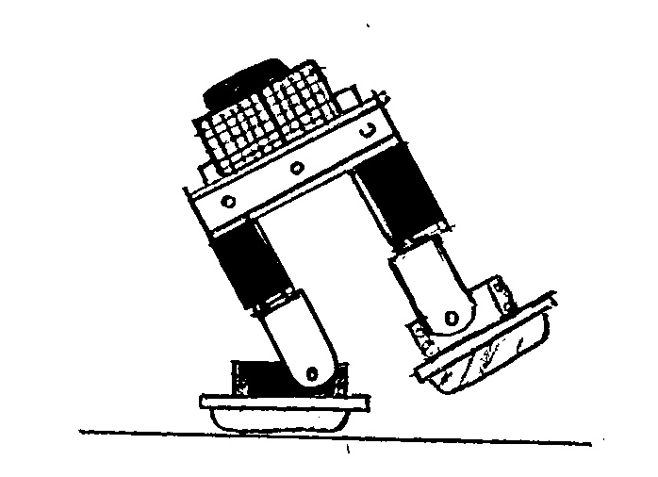
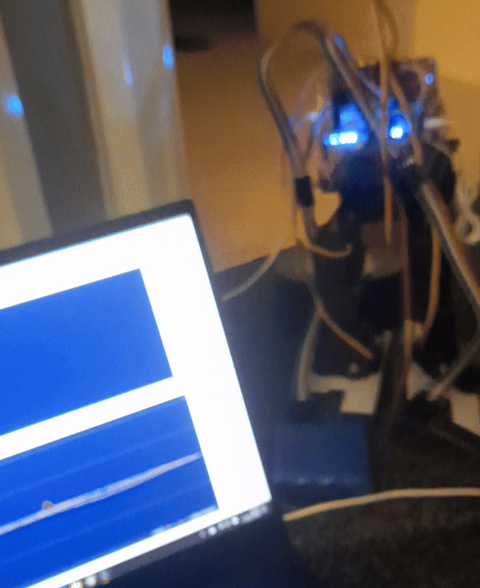
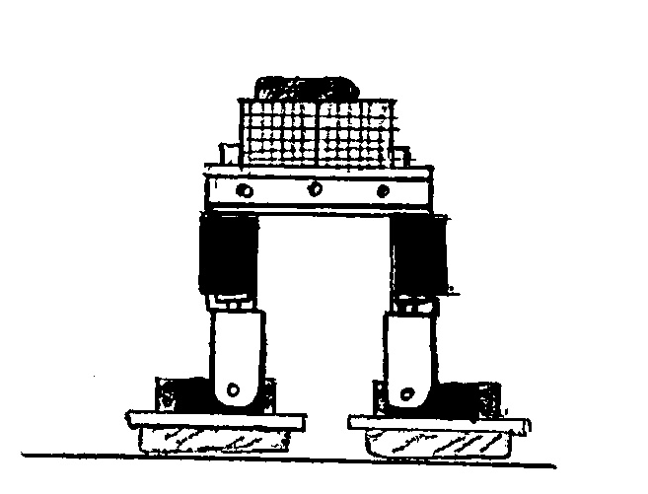
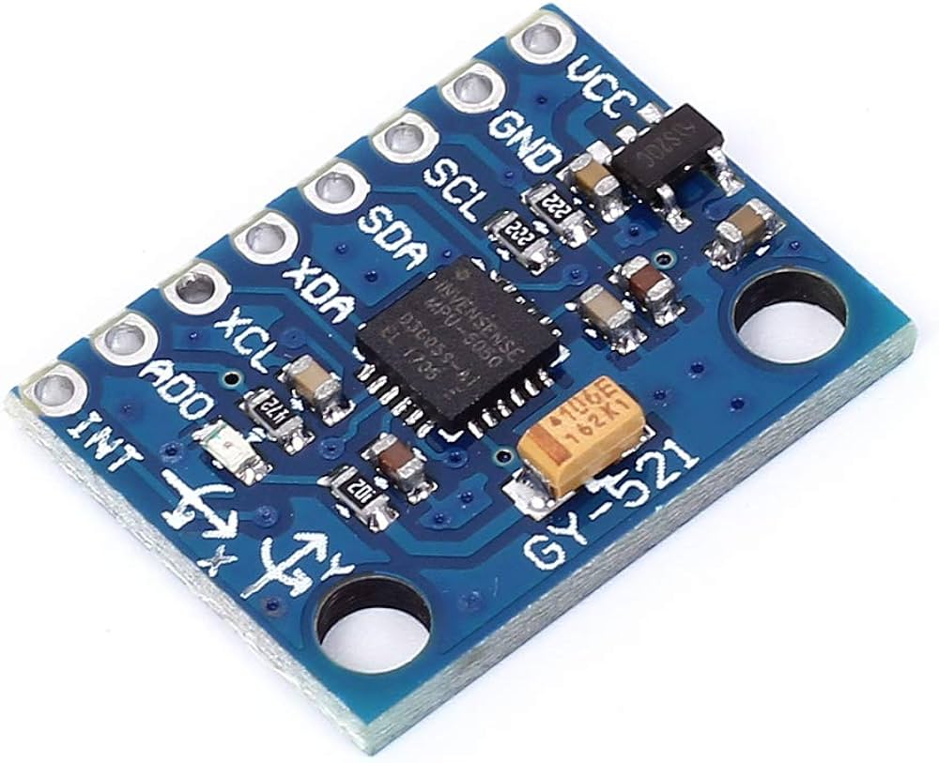
Trials
Tilting gave us tactile and tilt information from an MPU6050

Slide 10
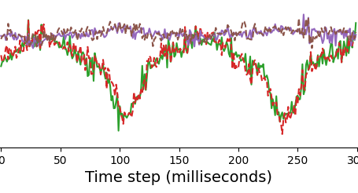
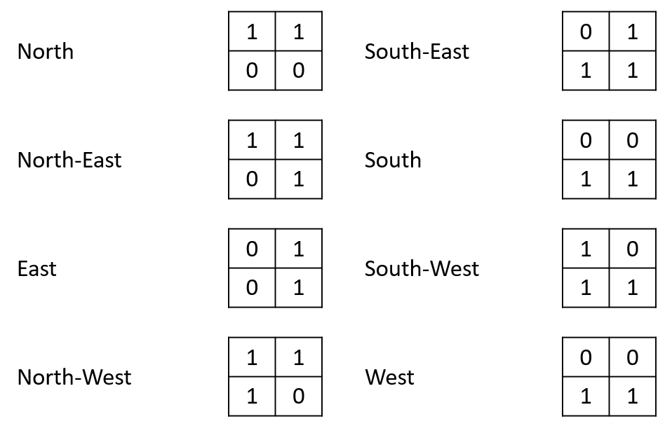
Our dataset and model
X
We deployed three models
Ridge Regression
Random forest regression
ANN
Labels
Pose
Temporal windows
Edge
[1,0,0,0]
Notes:
Intuition was regression is simpler and easier to train but ANN is good at finding more complex relationships

Slide 11
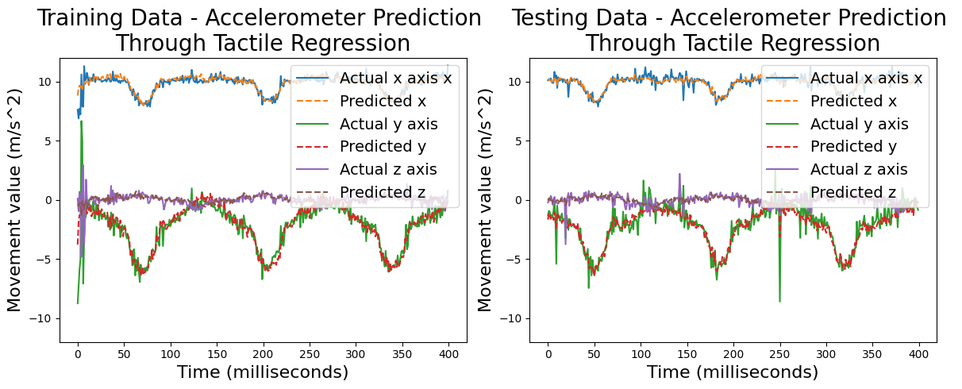
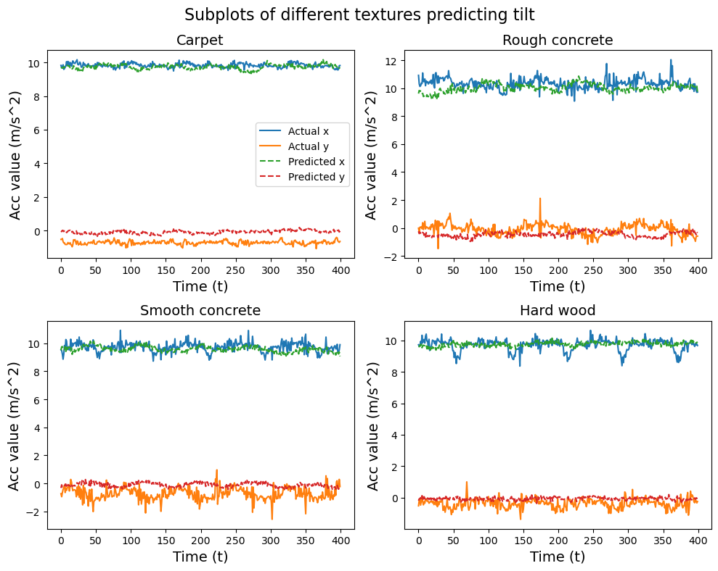
Results
Our models all performed well at predicting the tilt of the robot
Struggled more in different textures – but this could be good
ANN took much longer to train
Task | Ridge | RFR | ANN
Edge (accuracy) | 72.5% | 91.8% | --
Pose (min MSE) | 0.055 | -- | 0.050
Notes:
ANN took much longer to train

Slide 12
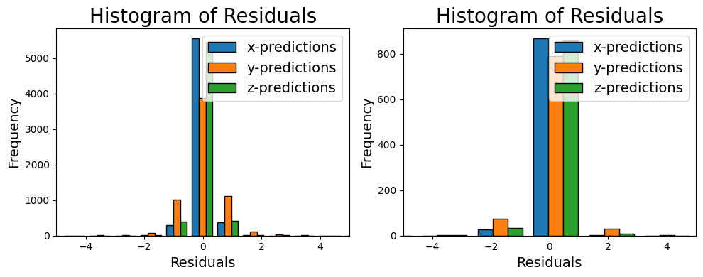
Which model should we pick?
Models performed at similar accuracies
Histogram of residuals gathered from Predicting acceleration in different directions in both the regression and ANN.
(Left) Regression model. (Right) ANN.
Notes:
Minimum taken from multiple trials

Slide 13
What does this mean
Do we want to replace accelerometers?
Understanding pose from tactile sensors gives better understanding of weight distribution

Slide 14
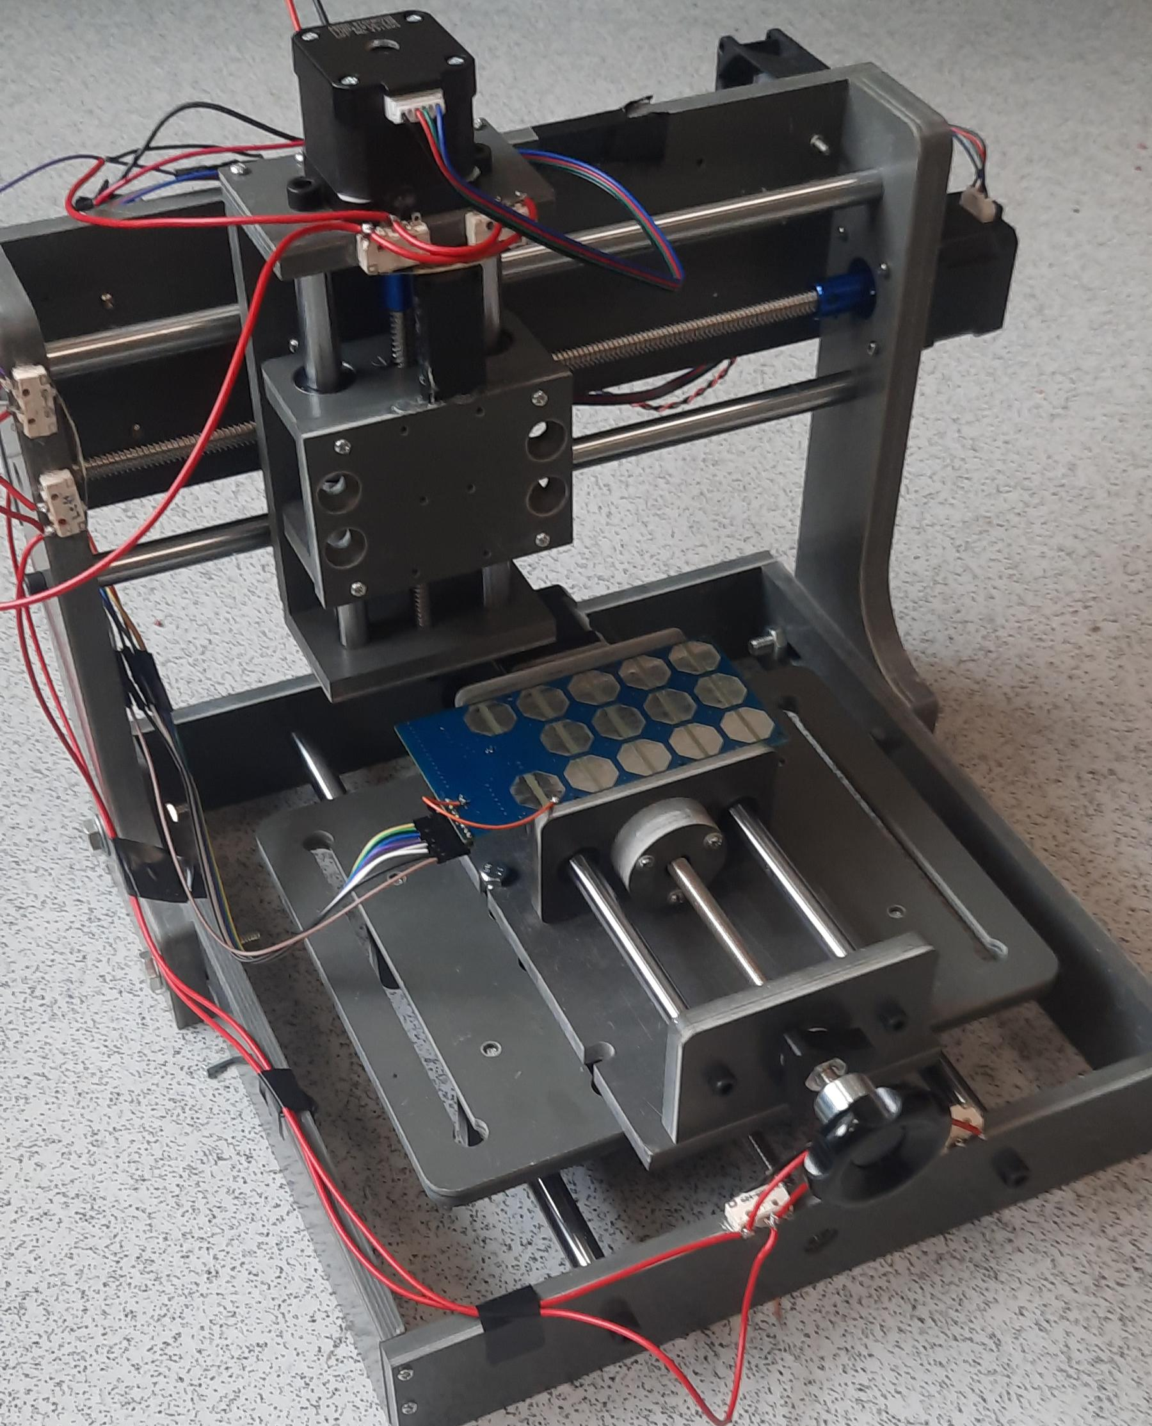
Future steps
Making more robust models from larger datasets of textures
Looking at real-time detection
Versatile cheap sensors working towards computationally efficient locomotion

Slide 15
Thank you!

